Slide 1


Book Recommendation System
Using Collaborative Filtering

Slide 2
Introduction
When an AI algorithm uses big data to make suggestions to users it is called a Recommendation System.
One of the most popularly applied concepts in these systems is called Collaborative Filtering.
Here, we make clusters of users based on their past preferences which is used as the determining factor while making new recommendations.
This is an alternative approach to the traditional one wherein we use the attributes or features of the product.

Slide 3

Objectives
The main goal is to thoroughly explore, understand the dataset to visualize the relationship between users, in order to successfully recommend a book which the user might actually be interested in reading.
The second objective is an extension of the first one, wherein I intend to make productive utilization of large amounts of generated data.

Slide 4



Collaborative Filtering
(In simple words..)
Suppose you go to a book reading event with your family. Your parents are avid readers so they have explored a wide ranges of genres with reading material from diverse collection of authors. After looking around, you turn to your parents for suggestions:
Parent A- The girl on the Train (Murder-Mystery)
Parent B- Love Rosie( Young Adult)
Your decision will depend on the parent who shares a similar reading taste with yours. If you generally have a common taste with Parent A, you will be more inclined towards their suggestion, however, if you generally have a similar preference to Parent-B, then you will choose the option suggested by them.
In essence, this is what CF implies, however instead of 2 user preferences, it compares your taste with that of a wide range of users.

Slide 5
Types of Collaborative Filtering
Item Based
IBCF is predicated on the idea that a user will favor a book that is comparable to books they have previously loved. For instance, if you enjoy comedies, IBCF will continue to suggest them to you.
User Based
According to UBCF, users who have had similar choices in the past will continue to have those same interests in the future. Therefore, we may use the book ratings from one user to predict the rating from the second user on a yet-to-be-read book if we know that two users have given extremely similar ratings to a collection of books.
Popularity Based
In this case CF simply recommends a list of popular items. These recommendations are not tailored to any specific user.

Slide 6
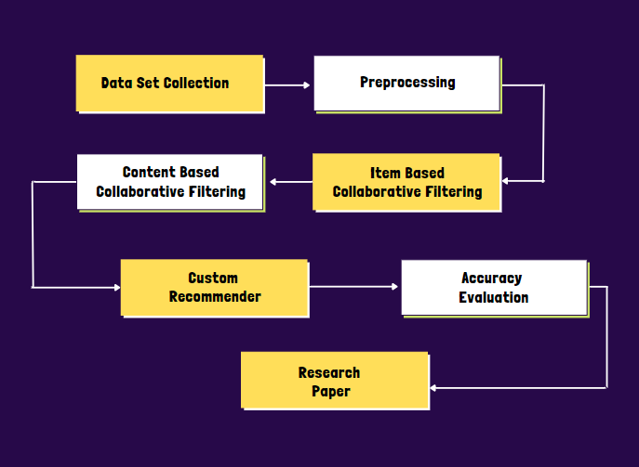
System Architecture

Slide 7
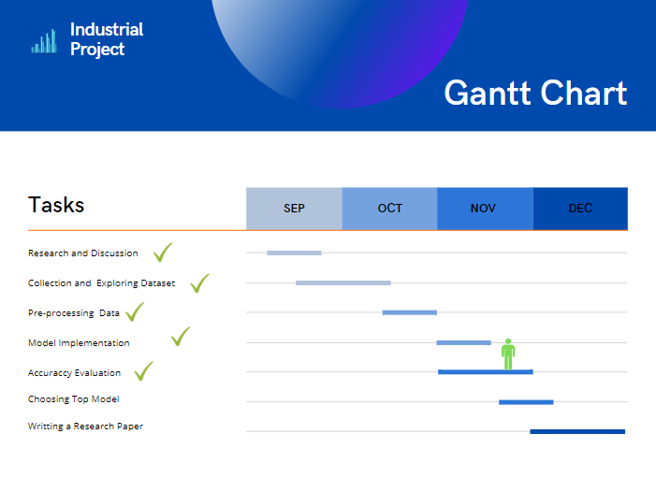
Plan

Slide 8
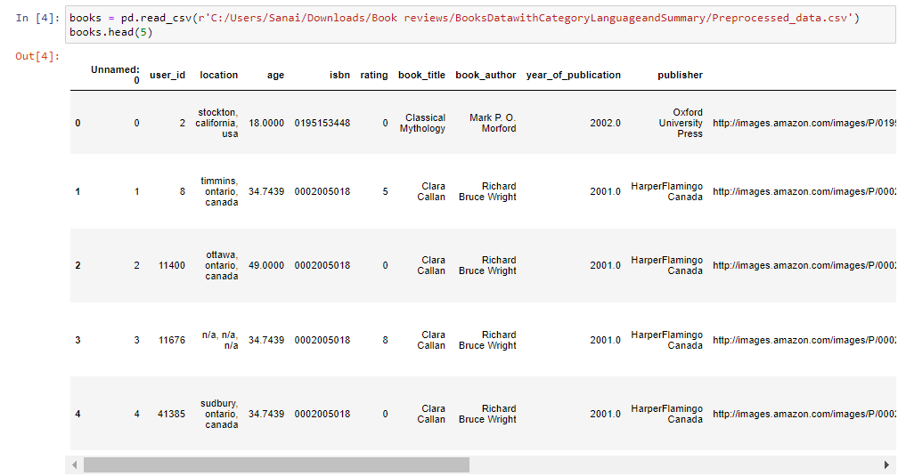
Data-Set
(Before Processing)
Contains 278,858 users (anonymized but with demographic information)
providing 1,149,780 ratings (explicit / implicit)
about 271,379 books entries gathered from Kaggle.

Slide 9
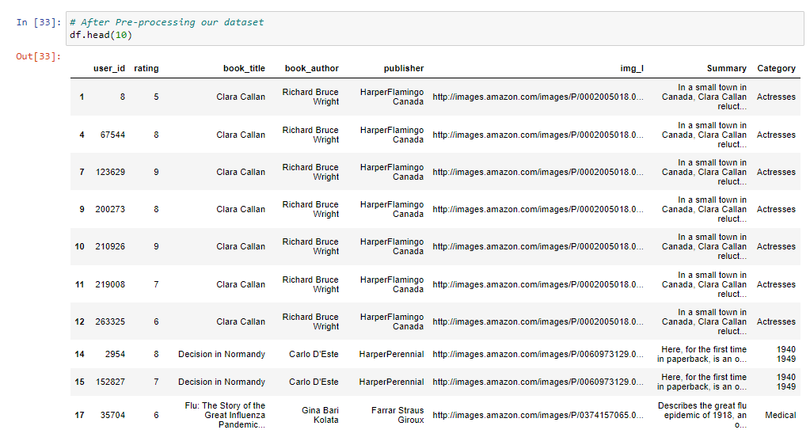
Data-Set
(After Processing)
cleaning the data:
removing punctuation marks, checking for null values.
we selected only the following columns:
user_id,rating,book_title,book_author,publisher,img,summary,category and dropped all the other columns.

Slide 10
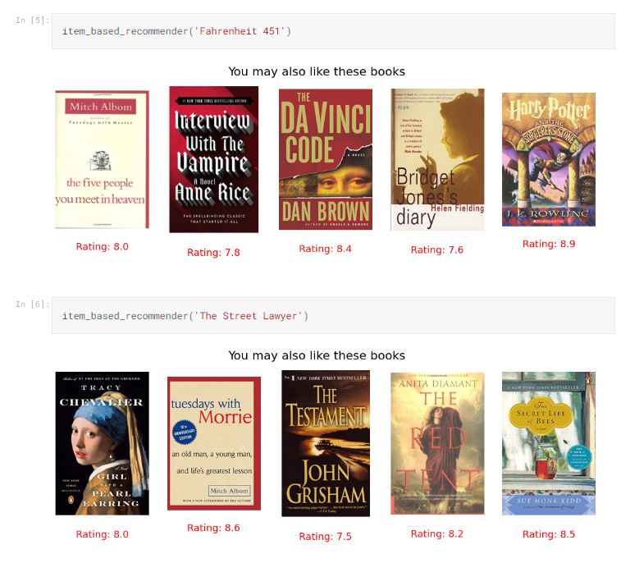
Item Based

Slide 11
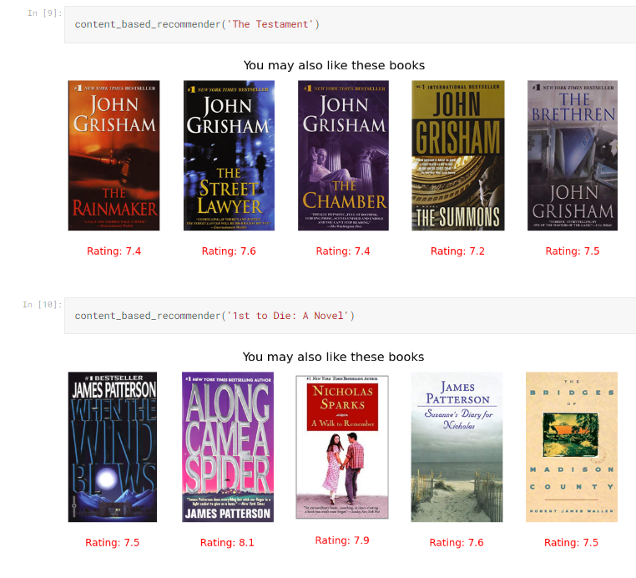
Content Based
(Title, Author, Publisher, Category)

Slide 12
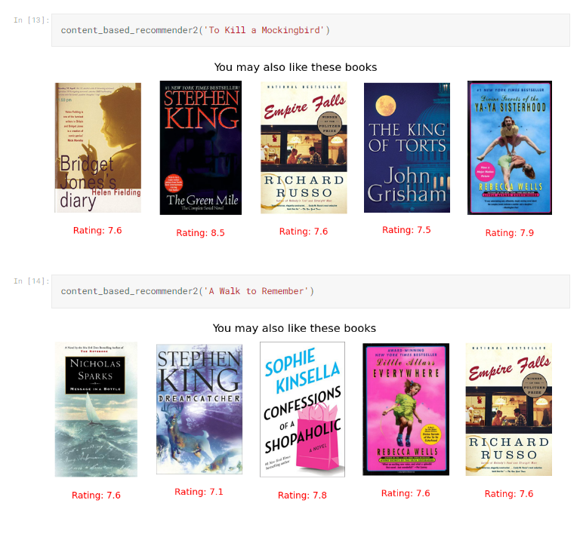
Content Based
(Summary)

Slide 13
Reference
[1] Avi Rana and K. Deeba et.al, “Online Book Recommendation System using Collaborative Filtering (With Jaccard Similarity)” in IOP ebooks 1362, 2019.
[2] G. Naveen Kishore, V. Dhiraj, Sk Hasane Ahammad, Sivaramireddy Gudise, Balaji Kummaraa and Likhita Ravuru Akkala, “Online Book Recommendation System” International Journal of Scientific & Technology Research vol.8, issue 12, Dec 2019.
[3] Uko E Okon, B O Eke and P O Asaga, “An Improved Online Book Recommender System using Collaborative Filtering Algorithm”, International Journal of Computer Applications vol.179-Number 46, 2018.
[4] Jinny Cho, Ryan Gorey, Sofia Serrano, Shatian Wang, JordiKai Watanabe-Inouye, “Book Recommendation System” Winter 2016.
[5] Ms. Sushma Rjpurkar, Ms. Darshana Bhatt and Ms. Pooja Malhotra, “Book Recommendation System” International Journal for Innovative Research in Science & Technology vol.1, issue 11, April 2015.

Slide 14
Reference
[6] Abhay E. Patil, Simran Patil, Karanjit Singh, Parth Saraiya and Aayusha Sheregar, “Online Book Recommendation System using Association Rule Mining and Collaborative Filtering” International Journal of Computer Science and Mobile Computing vol.8, April 2019.
[7] Suhas Patil and Dr. Varsha Nandeo, “A Proposed Hybrid Book Recommender System” International Journal of Computer Applications vol.6 – No.6,Nov – Dec 2016.
[8] Ankit Khera, “Online Recommendation System” SJSU ScholarWorks, Masters Theorem and Graduate Research, Master’s Projects, 2008. 58
[9] Anagha Vaidya and Dr. Subhash Shinde, “Hybrid Book Recommendation System” International Research Journal of Engineering and Technology (IRJET), July 2019.

Slide 15

Thanks!
Any questions?

